Slide 1
DIGITAL PORTFOLIO
STUDENT NAME: K.DEEPIKA
REGISTER NO AND NMID: astvu346m24664
DEPARTMENT: B.SC COMPUTER SCIENCE
COLLEGE/UNIVERSITY: M.M.E.S WOMEN'S ARTS AND SCIENCE COLLEGE

Slide 2

Building a Powerful Digital Portfolio: Showcase Your Professional Story

Slide 3
Problem Statement: Why Traditional Resumes Fall Short
1
2
Limited Insights
Demand for Proof
Resumes often provide only a static list of skills and job titles, offering limited insight into a candidate's actual capabilities and work ethic.
Employers and clients increasingly seek tangible evidence of creativity, problem-solving abilities, and the real-world impact of a candidate's work.
3
4
Competitive Edge
Bridging the Gap
In today's highly competitive job market, merely listing qualifications isn't enough; standing out requires a more dynamic and engaging presentation.
Digital portfolios effectively bridge this gap by visually showcasing projects, accomplishments, and the practical application of skills.

Slide 4
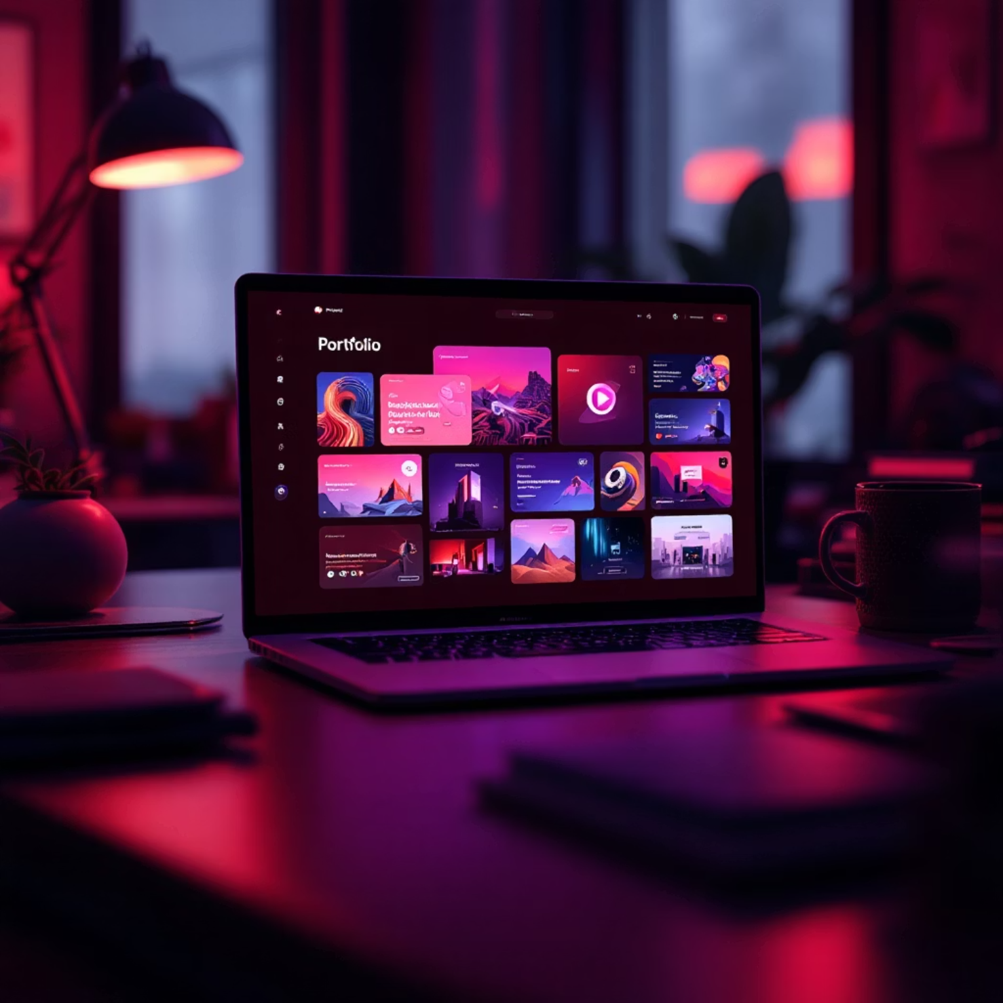
Project Overview: What is a Digital Portfolio?
A digital portfolio is an online, meticulously curated collection of your finest work samples, achievements, and professional experiences. It serves as a dynamic, accessible, and comprehensive professional scrapbook, available anytime, anywhere.
Unlike a static resume, a digital portfolio allows prospective employers and clients to gain a deeper understanding of your expertise, unique style, and value proposition. It has become an essential tool for professionals across various fields, including:
Designers
Developers
Marketers
Content Creators
Consultants

Slide 5




End Users: Who Benefits from a Digital Portfolio?
Job Seekers
Freelancers
Impress recruiters with tangible proof of skills and accomplishments, moving beyond basic resume claims to actual work samples.
Showcase diverse project experiences to attract new clients and demonstrate versatility across various assignments.
Students & Graduates
Networking Professionals
Build early credibility by presenting academic projects and internships, making a strong first impression in the professional world.
Leverage the portfolio as a powerful tool for networking and identifying collaboration opportunities within their industry.

Slide 6
Tools and Technologies Used
Website Builders
Canva, Wix, Google Sites: Ideal for quick, drag-and-drop design without coding knowledge, enabling visually appealing and responsive sites.
Developer Platforms
GitHub Pages: Perfect for custom-coded portfolios, offering version control and free hosting for developers to showcase their technical prowess.
Content Management
WordPress: Provides robust flexibility and scalability for complex portfolios, allowing extensive customisation through themes and plugins.
Design Tools
Adobe Portfolio, Figma: Essential for creating polished visual assets and mock-ups, integrating seamlessly with professional design workflows.
Integration
Embedding various media types such as videos, high-resolution images, and interactive elements (e.g., prototypes) for richer project displays.

Slide 7
Portfolio Design and Layout Principles
Clean & Intuitive
Prioritise Best Work
Consistent Branding
Ensure easy navigation with clear sections and a logical flow, allowing visitors to find information effortlessly.
Place your strongest and most recent projects prominently at the forefront to capture immediate attention.
Apply consistent fonts, colours, and logos that reflect your personal or professional brand identity across all pages.
Mobile-Friendly
Personal Connection
Optimise for all devices, ensuring fast loading times and a seamless user experience on both desktop and mobile.
Include a compelling "About Me" section and clear contact information to foster trust and facilitate communication.

Slide 8

Features and Functionalities to Include
Dynamic Project Galleries
Accessibility & Reach
Showcase your work with detailed descriptions, highlighting problem statements, solutions, and quantifiable outcomes for each project.
Provide a downloadable version of your resume for convenience and include intuitive contact forms for direct inquiries.
Interactive Elements
Network Integration
Integrate videos, animations, or live demos to provide an immersive experience of your projects and skills.
Link to your professional social media profiles (e.g., LinkedIn, Behance, GitHub) to expand your digital footprint and connections.
Credibility through Testimonials
Feature testimonials or client feedback to build trust and validate your expertise and work quality.

Slide 9
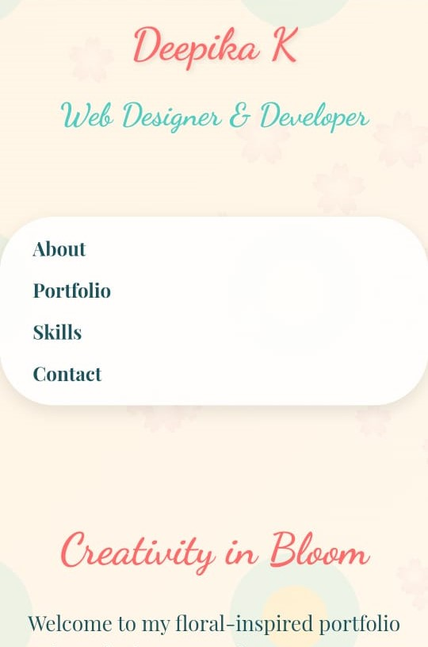
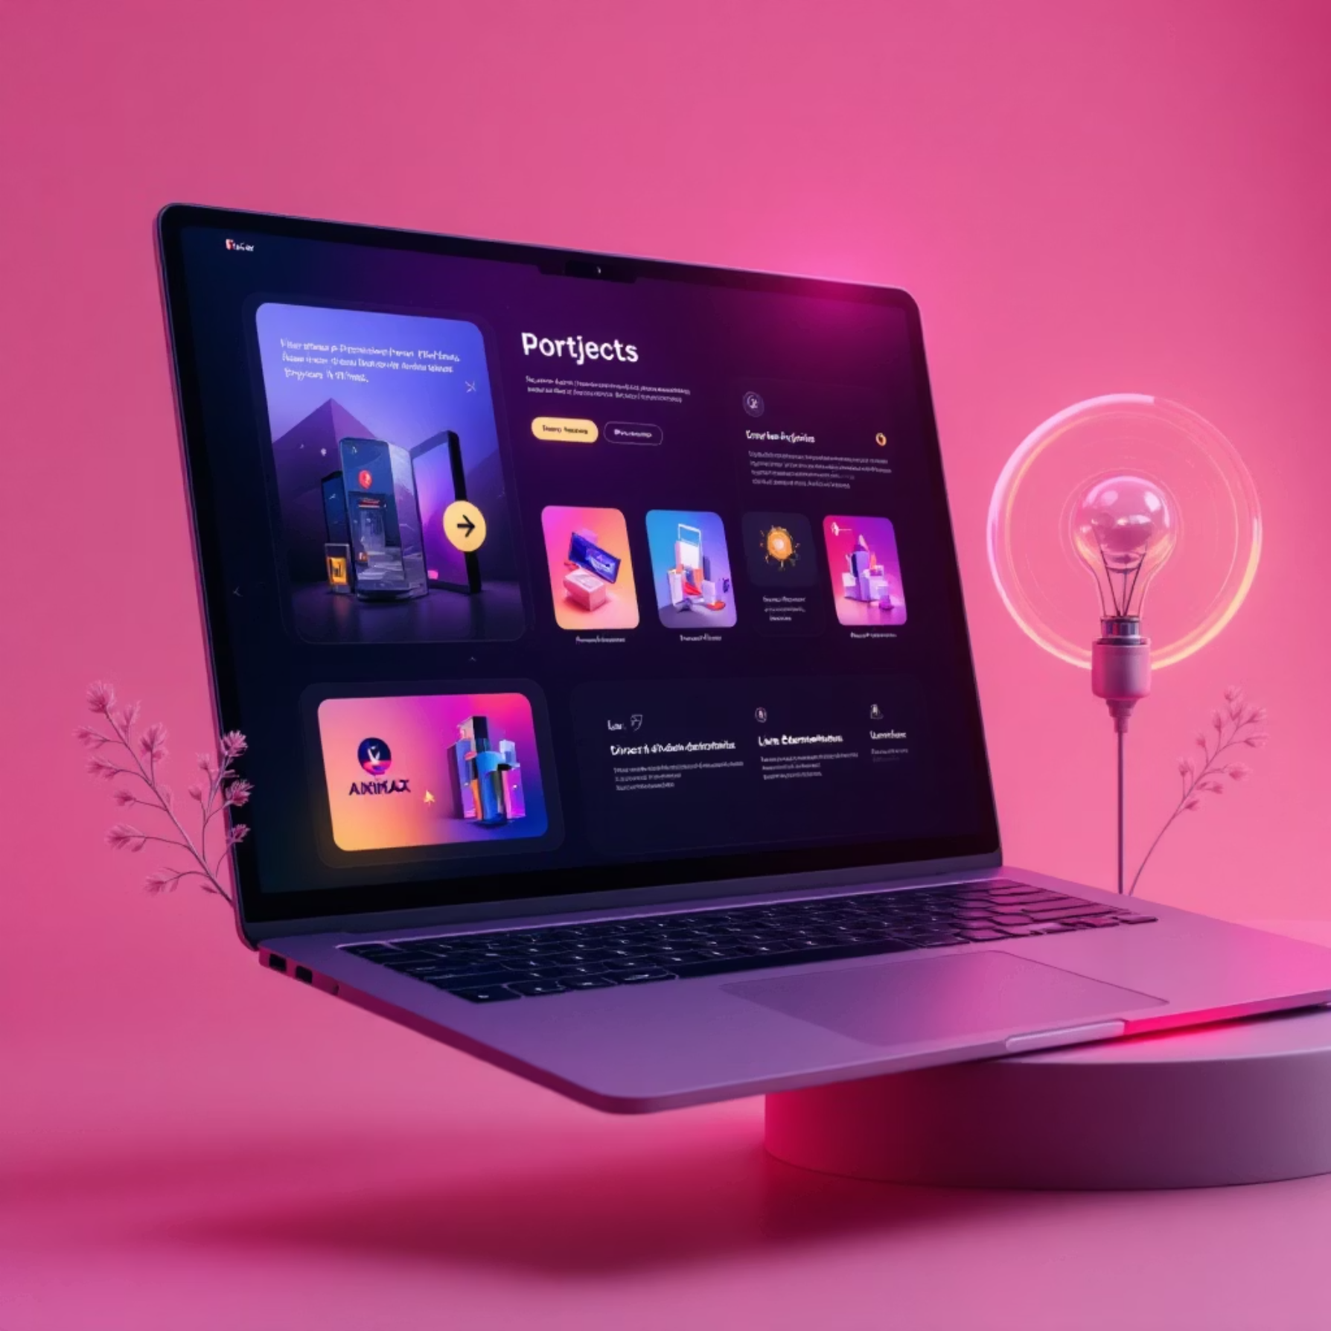
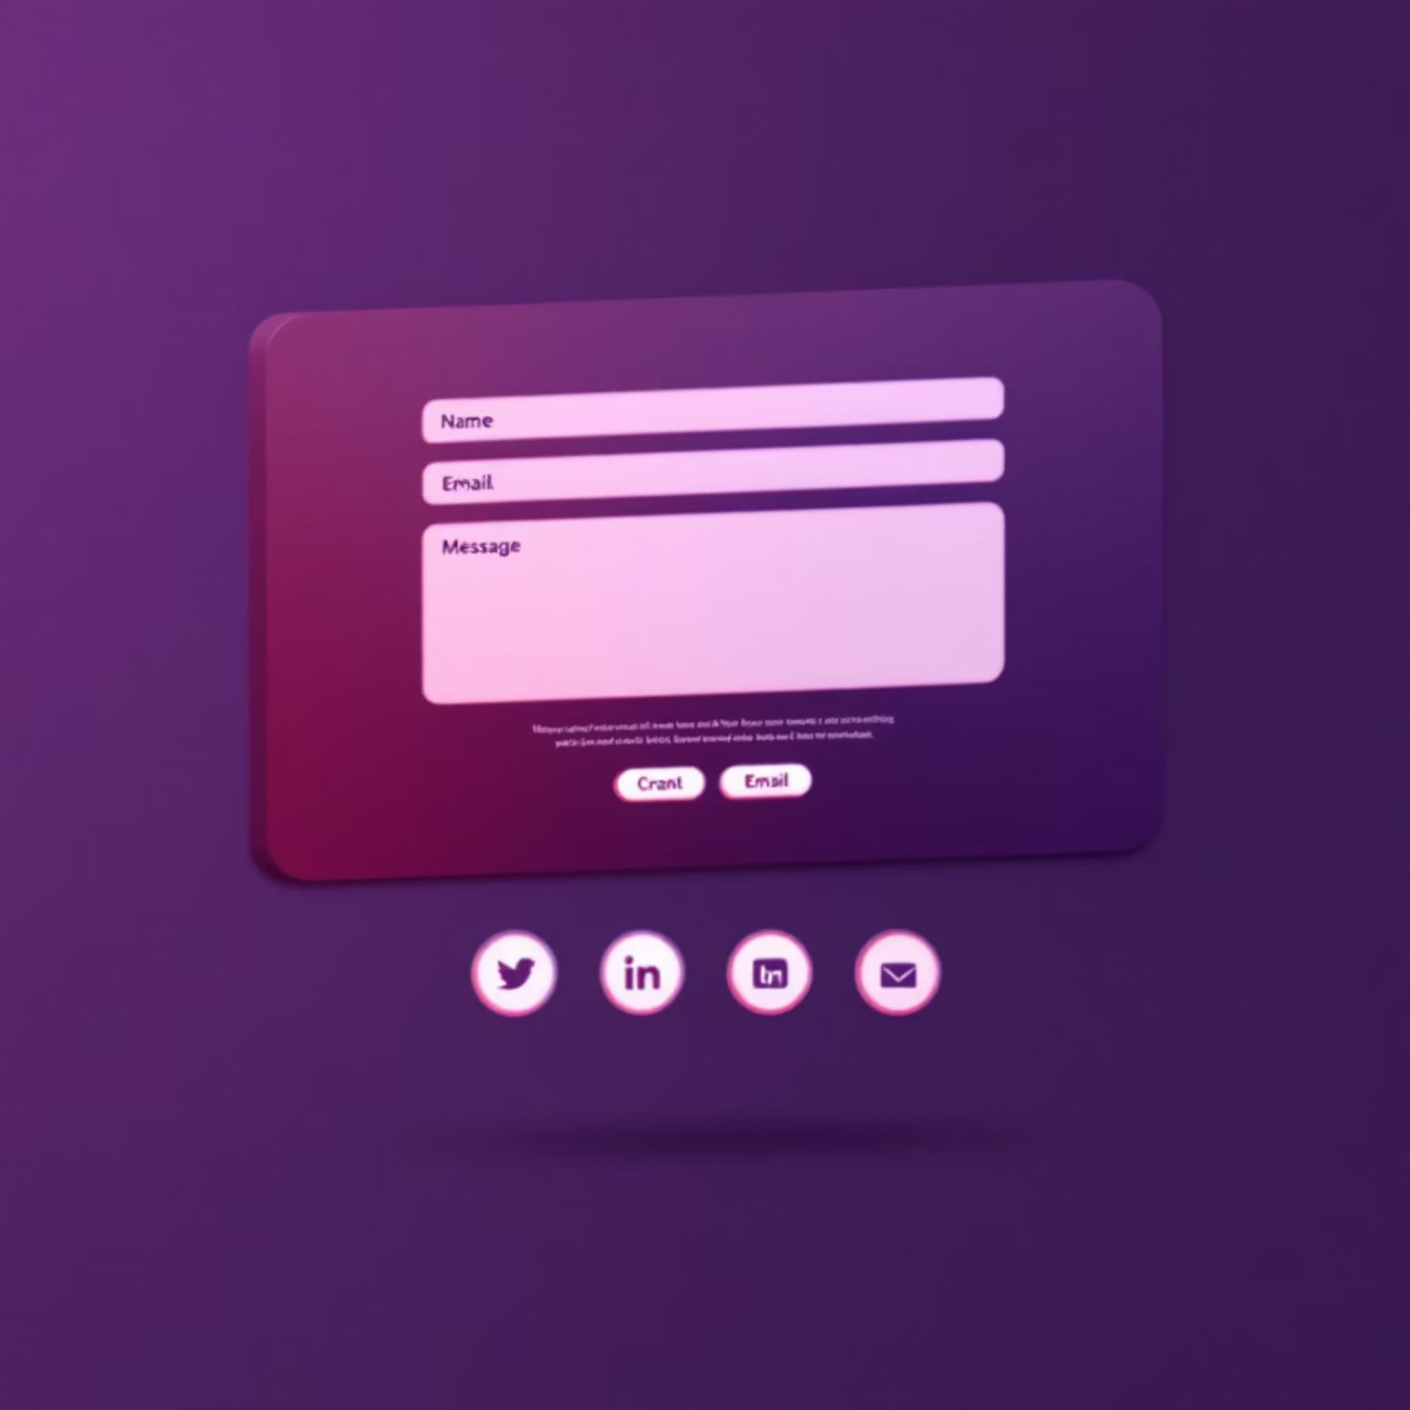
Results and Screenshots: Real-World Example
Homepage Snapshot
Project Showcase
A clean, branded header with intuitive navigation, guiding visitors effortlessly through different sections.
In-depth project displays with high-resolution images, concise descriptions, and direct links to live demos or case studies.
Contact Page
Quantifiable Outcome
Increased interview calls and client inquiries by 40% within just 3 months of launching the new digital portfolio. This demonstrates the tangible impact of a well-crafted online presence.
A user-friendly contact page featuring a direct inquiry form and integrated social media icons for broader connectivity.

Slide 10
Conclusion: Your Digital Portfolio is Your Career’s Best Advocate
1
Compelling Narrative
2
Unlocking Opportunities
It transforms your professional journey and accomplishments into a captivating visual story, leaving a lasting impression.
By making your skills undeniable and accessible, it opens doors to new career paths and client engagements.
3
Stay Relevant
4
Start Building Today
Easy to update and share, it ensures you remain current and competitive in a rapidly evolving professional landscape.
Equip yourself with the right tools and a strategic design mindset to begin crafting your powerful digital presence.

